Slide 1

ITU-R Working Party 5D
Introduction to IMT-2020
October 24, 2018
Håkan Ohlsén
Vice-Chairman - ITU-R Working Party 5D
Stephen M. Blust, P.E.
Chairman - ITU-R Working Party 5D
Sergio Buonomo
Counselor – ITU-R Study Group 5

Slide 2
Two Key & Interrelated Focus Areas for IMT-2020 & 5G Success
Both require global collaboration to be globally harmonized
Spectrum
Standards
ITU WRC Process
Mobile spectrum allocations and IMT identifications
ITU membership, ITU-R Study Groups, Regional Groups, International organisations
Member States driven
ITU-R Study Group 5 Process
IMT-2020 Vision, overall requirements, radio interface specifications
ITU membership, other standard making bodies
Industry driven
Reports & Recommendations approved by Member States
FP 2020-2023 - January 2018

Slide 3
IMT-2020 radio interface standardization process
Development plan
Market/services view
Technology/
research kick off
Vision - IMT for 2020
Name
Process
optimization
Technical
performance
requirements
Evaluation criteria
Invitation for proposals
Sharing study parameters (IMT-2020)
Sharing studies in preparation for WRC-19
Technical proposals
Evaluation Groups
Methodology
Consensus building
Spectrum/band
arrangements
Decision & radio framework
Detailed IMT-2020 radio specifications
Future enhancement/
update plan &
process
IMT-2020 spectrum allocation process
< 6 GHz Spectrum view
ITU-R Study Group activities/studies
Spectrum/band arrangements (post WRC-15)
CPM Report (IMT- WRC-19)
Sharing study reports
Spectrum/band arrangements (WRC-19)
2012-2015
2016-2017
2018-2019
2019-2020
Setting the stage for the future:
vision, spectrum, and technology views
Defining the technology
Allocate the spectrum
Notes:
Invitation to propose candidate radio interface technologies for IMT-2020 October 2017
Guidelines for both the procedure (methodology) and the criteria (technical, spectrum and service) to be used in the evaluation process November 2017
Submission of proposals for candidate radio interface technologies for the terrestrial components of the radio interface(s) for IMT-2020 November 2017
Independent evaluation groups started the assessment of the IMT-2020 radio interface technologies in October 2017, 11 groups active in February 2018
Deadline for submission of proposals : July 2018
Deadline for evaluation of proposals : December 2019

Slide 4
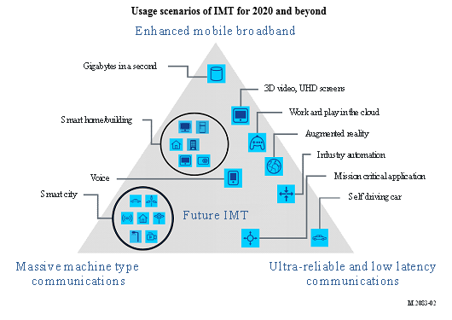
ITU Perspective – IMT 2020 (International Mobile Telecommunication)
Early 2012, ITU-R embarked on a global program to develop “IMT for 2020 and beyond”
Setting the stage for 5G research activities that are emerging around the world
Report ITU-R M.2320 – “Future technology trends of terrestrial IMT systems” (Nov 2014)
September 2015, ITU-R finalized “Vision” of the 5G mobile broadband connected society
Recommendation ITU-R M.2083 – “Framework and overall objectives of the future development of IMT for 2020 and beyond” (Sep 2015)
Defined the “usage scenarios” for IMT 2020 and beyond
Instrumental in setting the agenda for the World Radiocommunication Conference 2019

Slide 5
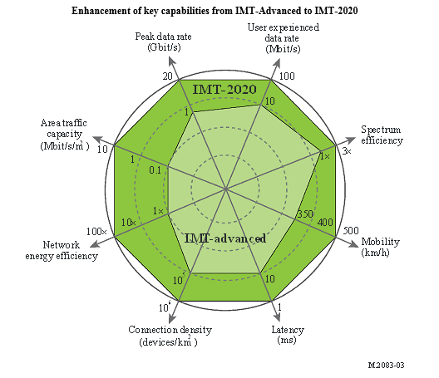
ITU Perspective – IMT 2020 (continued)
February 2017 – ITU completed a cycle of studies on the key performance requirements of 5G technologies for IMT-2020
November 2017 – adopted Report ITU-R M.2410, “Minimum requirements related to technical performance for IMT-2020 radio interface(s)”
describes those key requirements for the minimum technical performance of IMT-2020 candidate radio interface technologies
Candidate radio technologies – including 3GPP NR and a combination of LTE +NR - will be evaluated against these performance requirements utilizing Report ITU-R M.2412, (Nov 2017) “Guidelines for evaluation of radio interface technologies for IMT-2020”, which establishes defined evaluation criteria & scenarios
See next slides for timelines
Those meeting the requirements and the evaluation guidelines will be an “IMT-2020” technology.

Slide 6


Detailed Timeline & Process For IMT-2020 in ITU-R
2014
2015
2016
2017
2018
2019
2020
WRC-15
WRC-19
5D
#18
5D
#19
5D
#20
5D
#21
5D
#22
5D
#23
5D
#24
5D
#25
5D
#26
5D
#27
5D
#28
5D
#29
5D
#30
5D
#31
5Dª
#31
‘bis’
5D
#32
5D^{b}
#33
5D
#34
5D
#35
5D
#36
Report Technology trends (M.2320)
Technical Performance Requirements
Proposals IMT-2020
Report IMT feasibility above 6 GHz (M.2376)
Evaluation
Evaluation criteria & method
Consensus building
Recommendation Vision of IMT beyond 2020 (M.2083)
Requirements, Evaluation Criteria, & Submission Templates
Outcome & Decision
Workshop
Modifications of Res. 56/57 and new Res. 65
IMT-2020 Specifications
Circular Letters & Addendum
Background & Process
(IMT-2020/1,2)
(a) – five day meeting, (b) – focus meeting on Evaluation (Technology)

Slide 7
KEY ITU-R IMT-2020 Documents for the Evaluation (Technology Submission Focus)
(Source WP 5D)
Document IMT-2020/2 Rev1 – “Submission, evaluation process and consensus building for IMT-2020”
Report ITU-R M.2410 – “Minimum requirements related to technical performance for IMT-2020 radio interface(s)”
Report ITU-R M.2411– “Requirements, evaluation criteria and submission templates for the development of IMT-2020”
Report ITU-R M.2412 – “Guidelines for evaluation of radio interface technologies for IMT-2020”

Slide 8

Comparison of IMT Technology Developments in ITU-R
ITEM |  | IMT-2000 |  | IMT-Advanced |  | IMT-2020
VISION |  | M.687 & M.816 |  | M.1645 |  | M.2083
Year |  | 1992 |  | 2003 |  | 2015
Pages |  | 29 |  | 24 |  | 19
REQUIREMENTS |  | M.1034 |  | M.2134 |  | M.2410
Year |  | 1997 |  | 2008 |  | 2017
Pages |  | 28 |  | 8 |  | 9
SUBMISSION |  | 8/LCCE/47 + Add |  | M.2133 |  | M.2411
Year |  | 1998 |  | 2008 |  | 2017
Pages |  | 10 |  | 29 |  | 28
EVALUATION |  | M.1225 |  | M.2135 |  | M.2412
Year |  | 1997 |  | 2009 |  | 2017
Pages |  | 61 |  | 70 |  | 137
SPECIFICATIONS |  | M.1457-0 |  | M.2012-0 |  | M.[IMT-2020.SPECS]
Year |  | 2000 |  | 2012 |  | Anticipated published 2020
Current Version |  | M.1457-13 |  | M.2012-3 |  | -
Year |  | 2017 |  | Published early 2018

Slide 9
Future Planned Meeting Dates for Working Party 5D Following WRC‑15.
Please check the ITU website in case meeting details have changed (http://www.itu.int/events/monthlyagenda.asp?lang=en).
GROUP | No. | FROM | TO | PLACE
WP 5D | 23 | 23 February 16 | 2 March 16 | China
WP 5D | 24 | 14 June 16 | 22 June 16 | Geneva
WP 5D | 25 | 5 October 16 | 13 October 16 | Geneva
WP 5D | 26 | 14 February 17 | 22 February 17 | Geneva
WP 5D | 27 | 13 June 17 | 21 June 17 | Canada
WP 5D | 28 | 3 October 17 | 11 October 17 | Germany
WP 5D | 29 | 31 January 18 | 7 February 18 | Korea
WP 5D | 30 | 13 June 18 | 20 June 18 | Mexico
WP 5D | 31 | 9 October 18 | 16 October 18 | Japan
WP 5D | 31bis | 11 February 19 | 15 February 19 | Geneva
CPM19-2 | – | 18 February 19 | 28 February 19 | Geneva
WP 5D | 32 | 9 July 19 | 17 July 19 | [Geneva]
SG 5 | – | 2 September 19 | 3 September 19 | Geneva
RA-19 | – | 21 October 19 | 25 October 19 | Egypt
WRC-19 | – | 28 October 19 | 22 November 19 | Egypt
WP 5D | 33 | [9 December] 19 | [13 December] 19 | [Geneva]
WP 5D | 34 | 19 February 20 | 26 February 20 | [TBD]
WP 5D | 35 | 24 June 20 | 1 July 20 | [TBD]
WP 5D | 36 | 7 October 20 | 14 October 20 | [TBD]
SG 5 |  | 23 November 20 | 24 November 20 | Geneva

Slide 10
WP 5D Workshop on IMT-2020 Terrestrial Radio Interfaces Evaluation
WP 5D intends to have a workshop for IMT-2020 focusing on the evaluation of the candidate terrestrial radio interfaces in conjunction with its 32nd meeting in July 2019, with presentations from the proponents, IEGs, and the WP 5D experts. This will facilitate the IEGs to understand the details of the proposed candidate technologies, and to interact with WP 5D and others participating in the ITU-R evaluation process on IMT‑2020.
Information about the workshop will be appropriately communicated and/or updated on the WP 5D webpage https://www.itu.int/en/ITU-R/study-groups/rsg5/rwp5d/Pages/default.aspx

Slide 11
IMT-2020 ‘In-Progress’ Candidate Radio Interface Technology “Initial Submissions” to WP 5D as of Meeting #31 October 2018
SUBMITTED PROPOSALS FOR IMT-2020
‘3GPP’
IMT-2020/3
(Rev. 2)
SRIT: LTE+NR
RIT: NR
‘KOREA’
IMT-2020/4
(Rev. 2)
RIT: NR
‘CHINA’
IMT-2020/5
(Rev. 2)
SRIT: LTE+NR
RIT: NR
‘DECT Forum & ETSI’
IMT-2020/5
(Rev. 1)
RIT: DECT-2020
‘TSDSI’
IMT-2020/7
(Rev. 1)
SRIT: LTE+NR
RIT: NR
“RIT/SRIT Proponent”:
Collectively 3GPP OPs
( ARIB,ATIS,CCSA, ETSI, TTA, TTC, TSDSI)
Korea
China
DECT Forum & ETSI
TSDSI
To be available on the ITU website shortly

Slide 12
WRC-19 AI 1.13 sharing & compatibility studies
24.25 GHz
Incumbent services
Mobile-satellite Radionavigation-satellite service
Fixed-satellite Broadcasting-satellite
Radio astronomy
Space research Earth exploration-satellite
Inter-satellite
Earth exploration-satellite (passive) Space research (passive)
Fixed
Mobile – Multiple gigabit wireless systems
Aeronautical mobile Radiodetermination
Focus on
24.25 – 27.5 GHz
(31.8 – 33.4 GHz)
37 – 43.5 GHz
(45.5 – 47.2 GHz)
47.2 – 50.2 GHz
50.4 – 52.4 GHz
66 – 86 GHz
Selected frequency bands
Mobile service
IMT-2020 SPECTRUM
86 GHz

Slide 13
Conclusions
Global collaboration and joint effort leads to success for IMT-2020 and 5G.
ITU-R and industry partnerships remain strong and well aligned for IMT-2020 and 5G.
Engagement by Administrations is high - both on spectrum and technology.
ITU-R IMT-2020 vision continues as the global target in support of 5G.
Initial IMT-2020 candidate radio interface technology submissions already being received – final submissions due July 2019.
The Evaluation process has started! - advance activities already underway by independent evaluation groups.
ITU-R Recommendation on detailed radio interface technology specifications for IMT-2020 on track for year-end 2020 release.
ITU-R is well on schedule to implement all necessary procedures to identify the important future ‘mm wave’ spectrum (WRC-19) within the IMT overall spectrum portfolio.

Slide 14
Thank You!

